Slide 1
Chapter:7.4
Acids and Bases

Slide 2
Naturally our environment is acidic. Rain is slightly acidic. Soft drinks contain carbonic acid. Citrus fruits contain citric acid and many foods contain vitamin C, which is ascorbic acid. Proteins are long chains of amino acids and our stomach produces HCl for the ion of food.
Bases are part of our natural environment. Ammonia is a base found in volcanic gases and produced by rotting plant and animal matter. Caffiene found in coffee and tea, is a base as is nicotine, which is in tobacco.

Slide 3
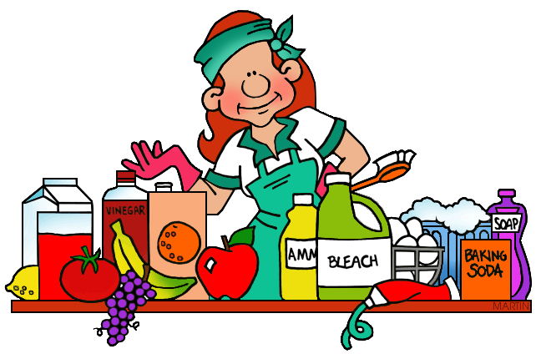
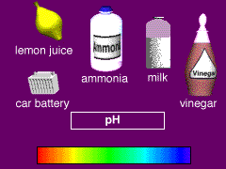
Definitions of acids & bases
Common Properties of acids
A sour taste
Sting or burn the skin
Turn blue litmus red
Common Properties of bases
A slippery feel in aqueous solution
A bitter taste
Conduct electricity in solution (not all bases are soluble- soluble bases are called as alkali’s.)
Turn red litmus blue

Slide 4
Effects of acids and bases on vegetable dyes like litmus was initially used to classify substances as acids and bases. French scientist Antoine Lavoisier ( 1743-94) was one of the first to try to establish what an acid is .
In 19th century, Swedish chemist Svante Arrhenius attempted to explain acids and bases in terms of particles they produced in aqueous solution.
He proposed that acids were substances that ionised in solution to produce hydrogen ions and that acids are strong if they ionised completely and weak if they ionised only slightly.

Slide 5
Definition of a base is quite general. Most oxides formed between a non- metal and oxygen ( for example CO2 and SO3 ) are acidic or neutral, while those formed between a metal and oxygen ( basic for example CaO and MgO) are basic or amphoteric (a molecule or ion that can react as an acid as well as a base. The word is derived from the Greek word amphoteroi meaning "both“)

Slide 6
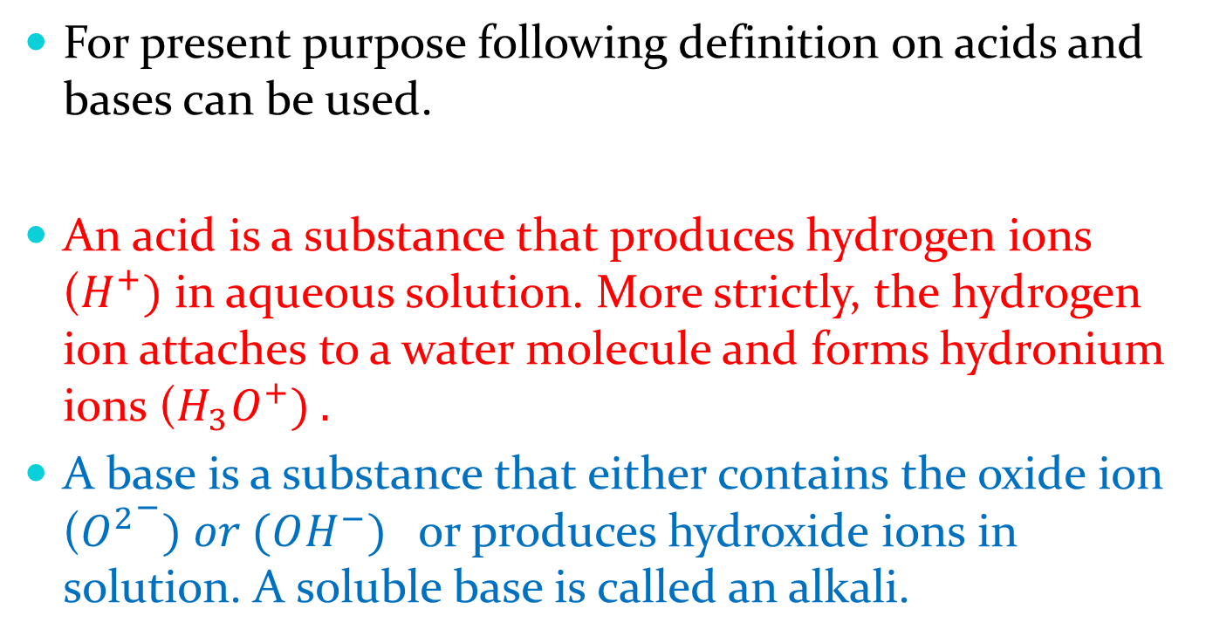
For present purpose following definition on acids and bases can be used.
An acid is a substance that produces hydrogen ions ($H^{+})$ in aqueous solution. More strictly, the hydrogen ion attaches to a water molecule and forms hydronium ions ($H_{3}O^{+}) .$
A base is a substance that either contains the oxide ion (${O^{2}}^{−}) or (OH^{−})$ or produces hydroxide ions in solution. A soluble base is called an alkali.

Slide 7
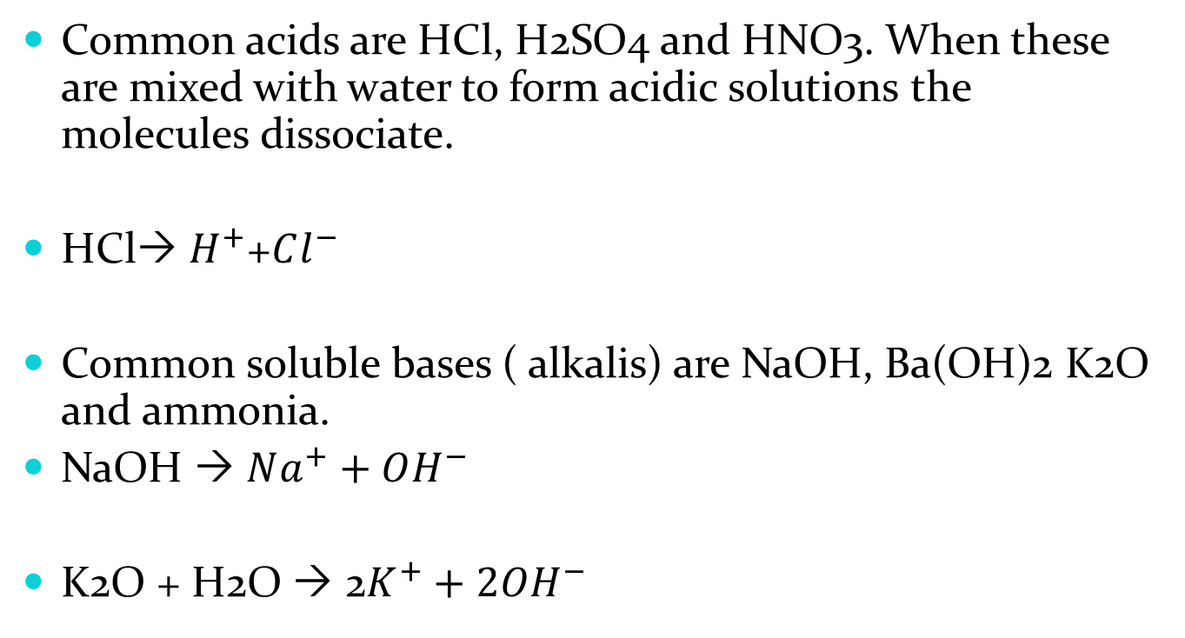
Common acids are HCl, H2SO4 and HNO3. When these are mixed with water to form acidic solutions the molecules dissociate.
HCl $H^{+}$+$Cl^{−}$
Common soluble bases ( alkalis) are NaOH, Ba(OH)2 K2O and ammonia.
NaOH  $Na^{+}+OH^{−}$
K2O + H2O  2$K^{+}+2OH^{−}$

Slide 8
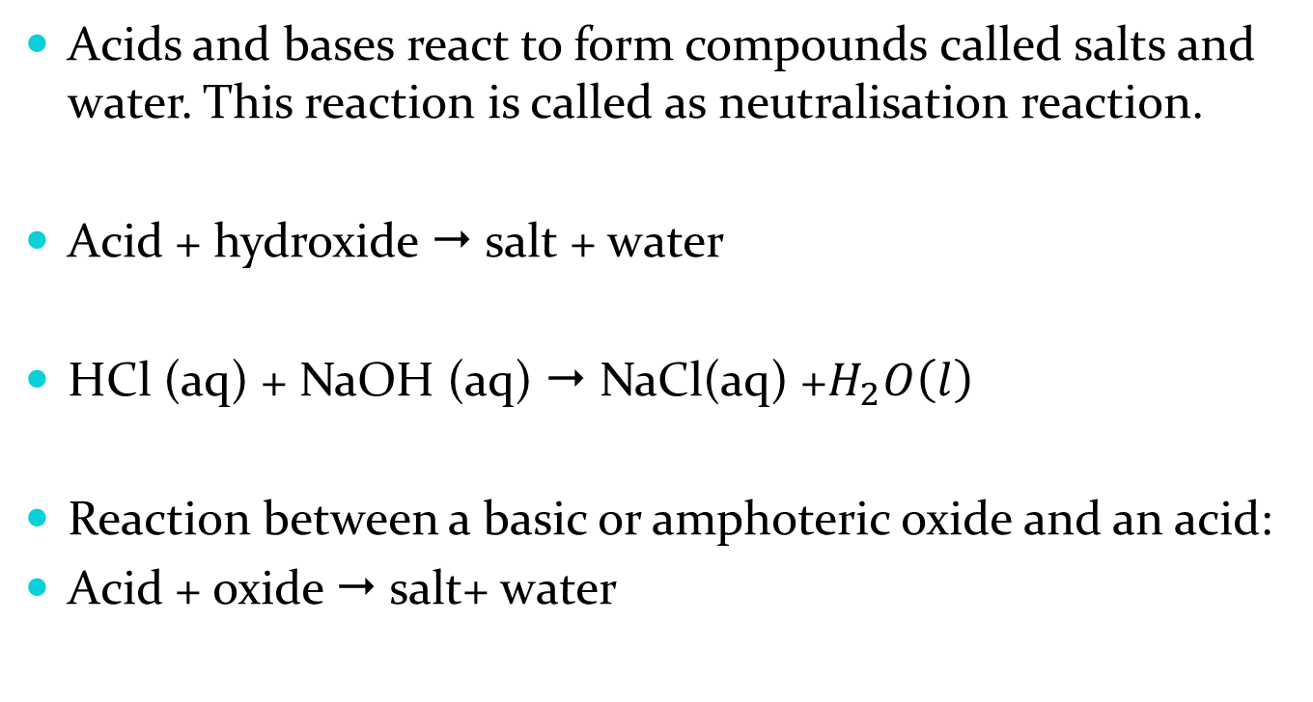
Acid –base reactions
Acids and bases react to form compounds called salts and water. This reaction is called as neutralisation reaction.
Acid + hydroxide  salt + water
HCl (aq) + NaOH (aq)  NaCl(aq) +$H_{2}O\left(l\right)$
Reaction between a basic or amphoteric oxide and an acid:
Acid + oxide  salt+ water

Slide 9
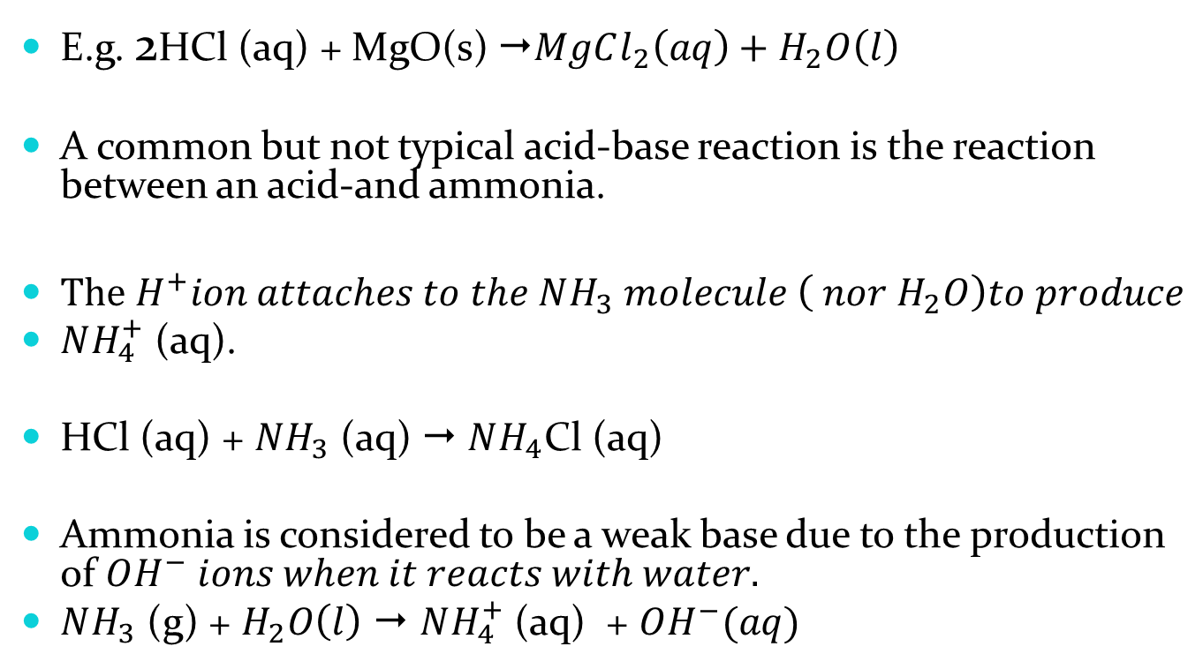
E.g. 2HCl (aq) + MgO(s) $MgCl_{2}\left(aq\right)+H_{2}O\left(l\right)$
A common but not typical acid-base reaction is the reaction between an acid-and ammonia.
$The H^{+}ion attaches to the NH_{3} molecule \left( nor H_{2}O\right)to produce$
$NH_{4}^{+}$ (aq).
HCl (aq) + $NH_{3}$(aq)  $NH_{4}$Cl (aq)
Ammonia is considered to be a weak base due to the production of $OH^{−} ions when it reacts with water.$
$NH_{3}$ (g) + $H_{2}O\left(l\right)$  $NH_{4}^{+}$ (aq) + $OH^{−}(aq)$

Slide 10
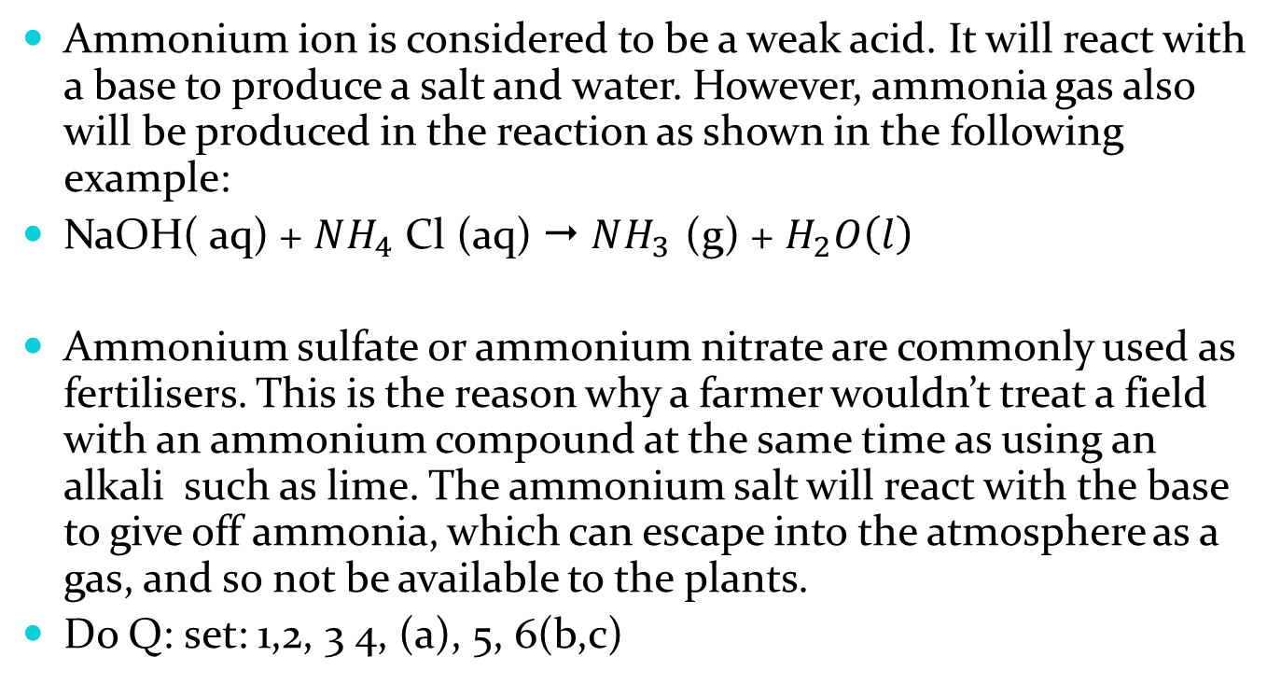
Ammonium ion is considered to be a weak acid. It will react with a base to produce a salt and water. However, ammonia gas also will be produced in the reaction as shown in the following example:
NaOH( aq) + $NH_{4}$ Cl (aq)  $NH_{3 }$(g) + $H_{2}O\left(l\right)$
Ammonium sulfate or ammonium nitrate are commonly used as fertilisers. This is the reason why a farmer wouldn’t treat a field with an ammonium compound at the same time as using an alkali such as lime. The ammonium salt will react with the base to give off ammonia, which can escape into the atmosphere as a gas, and so not be available to the plants.
Do Q: set: 1,2, 3 4, (a), 5, 6(b,c)

